Slide 1




HOMES
Habitat Orientable & Modular Electrodynamic Shield
E100 Progress Report – 4/9/21
Professor: Dr. Soon-Jo Chung
Notes:
Malcolm

Slide 2
ADMIN
Agenda
4/9/21
Malcolm
Facilities and Funding Announcement – 2 mins
Gantt Chart Overview – 10 mins
Feedback form – 2 min
Progress reports – 40 mins
Next steps – 6 mins

Slide 3
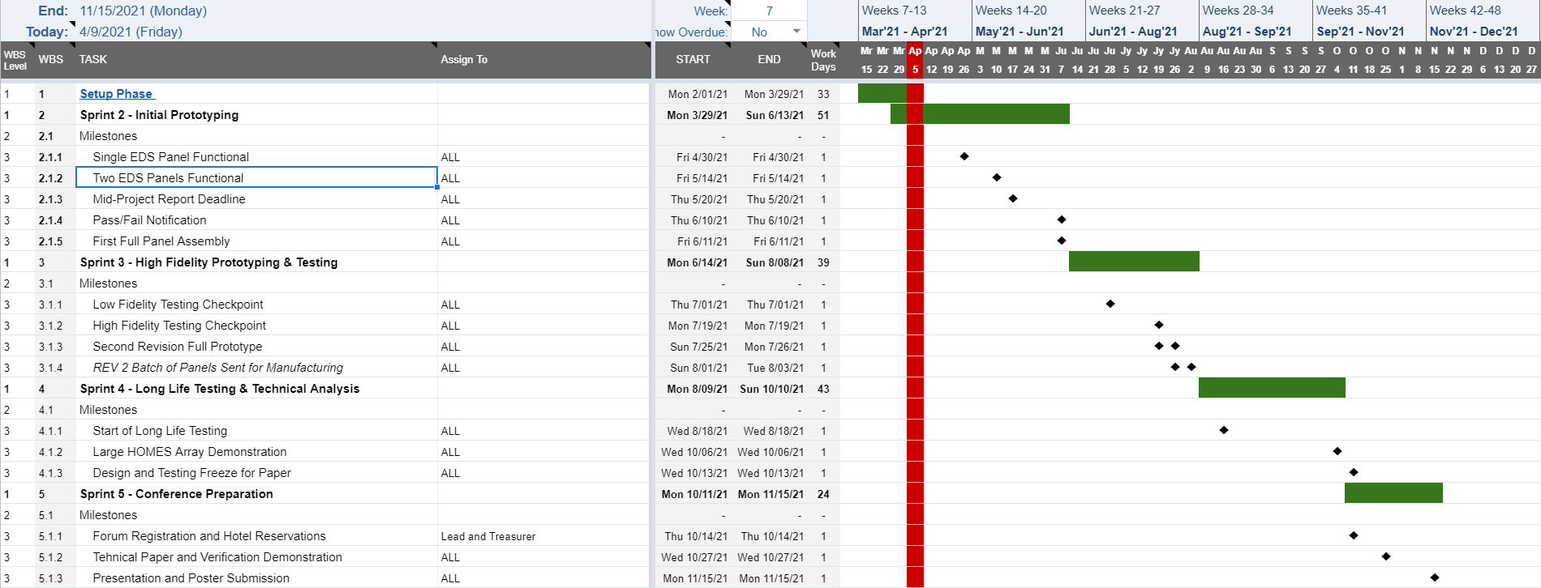
ADMIN
Gantt Overview
4/9/21
Malcolm

Slide 4
ELECTRICAL
WORK PLAN
04/09/21
Amrita Mayavaram
 | EDS Design | Power Supply | Microcontroller
4/2 - 4/8 | Design & order test boards | Implement CDR feedback Design PCB | Get familiar with arduino
4/9 - 4/15 | Contact companies for custom connectors Revise large PCB design Create test plan | Bootstrap circuitry Order PCB | Program phases
4/16 - 4/22 | Soldering/Help with tests Continue design work | Space grade components | Help with tests Operational mode programming
4/23 - 4/29 | Design and order PCB for single panel prototype | Modify design and order new PCB if needed | Operational mode programming
4/30 - 5/6 | Contact rigid flex PCB manufacturers | Space grade components | Operational mode programming
5/7 - 5/13 | Soldering/Help with tests | Modify design based on tests | Soldering/ Help with tests
5/14 - 5/20 | Writing | Writing | Writing
5/21 - 5/27 | Revise designs based on test results Order rigid flex PCB | Modify design and order PCB | Look into more advanced controls
5/28 - 6/3 | Finalize and order additional components | Finalize and order additional components | Controls design
IMPORTANT TARGET DATES
4/24 – Informal Design Review
4/30 – Order Deadline for Mid-Project Report Prototype
5/10 – Complete Assembly of Electronics for MPR Prototype
5/30 – Order Deadline for End-of-Term Prototype

Slide 5
ELECTRICAL
BUDGET
04/09/21
Amrita Mayavaram
EDS Design |  | Power Supply |  | Microcontroller
Item | Price | Item | Price | Item | Price
Test Boards | $250 | Earth Prototype Components | $1,000 | Arduino | $25
HV Wire | $30 | Test PCB | $100 | Breadboard | $10
Rigid PCBs | $400 | 2nd Test PCB + Components | $1,100
Rigid Flex PCBs | $1,000 | Breadboard (wood) | $20
Connectors | $1,000 | Space Grade Components | $5,000
Acrylic Conformal Coating | $25 | Space Grade PCB | $300
Subtotal | $2,705 |  | $7,520 |  | $35
 |  |  |  | TOTAL | $10,260

Slide 6
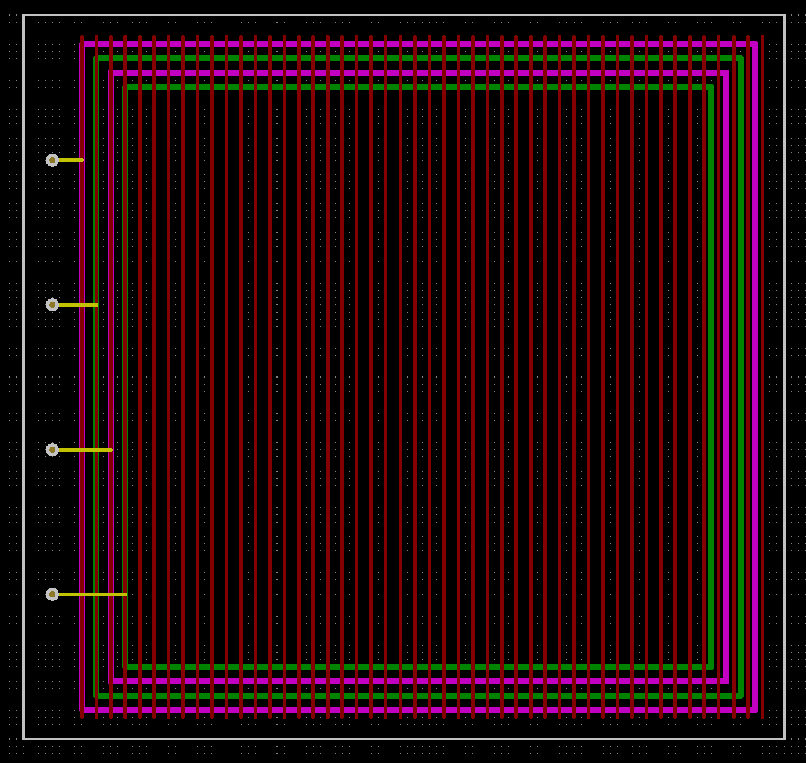
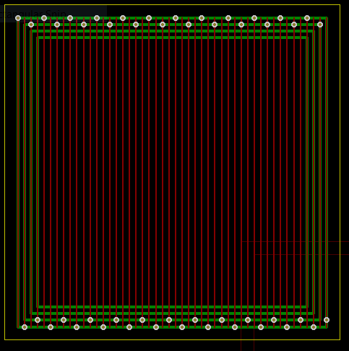
ELECTRICAL
EDS DESIGN
04/09/21
Amrita Mayavaram, Hope Arnett, Jules Pénot
Test Board 1
Test Board 2

Slide 7
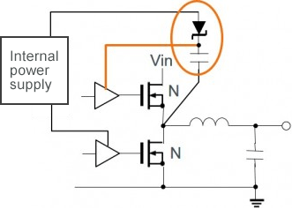
Electrical
Power Supply and Switching
04/09/21
Kemal Pulungan
Technical Updates
Received advice from James Phillips regarding circuit
In its current state, the MOSFETs would fail
Recommends bootstrap circuitry for switching high voltages, which I am reading up on to put in the circuit.
Circuit Board for Electronics – Discussed how to design it (KiCAD), standards for doing so (IPC-2221), and safety working with high voltage. Still need to implement bootstrap circuitry to finish design

Slide 8
Electrical
Power Supply and Switching
04/09/21
Kemal Pulungan
Work Plan
4-9 to 4-16: Finishing bootstrap circuitry and PCB design
4-16 to 4-23,30: Overseeing construction of the first board (will not be in-person)
Afterwards up to mid-May: Testing of electronics
Budget
Around $1000, maximum $2000 for one electronics box
Current list below, still subject to changes from James’s recommendations:
https://docs.google.com/document/d/1OB4kSlLJixkQM1dVFev7hlX4f0RqRDF6c5C8Sh-qFfM/edit

Slide 9
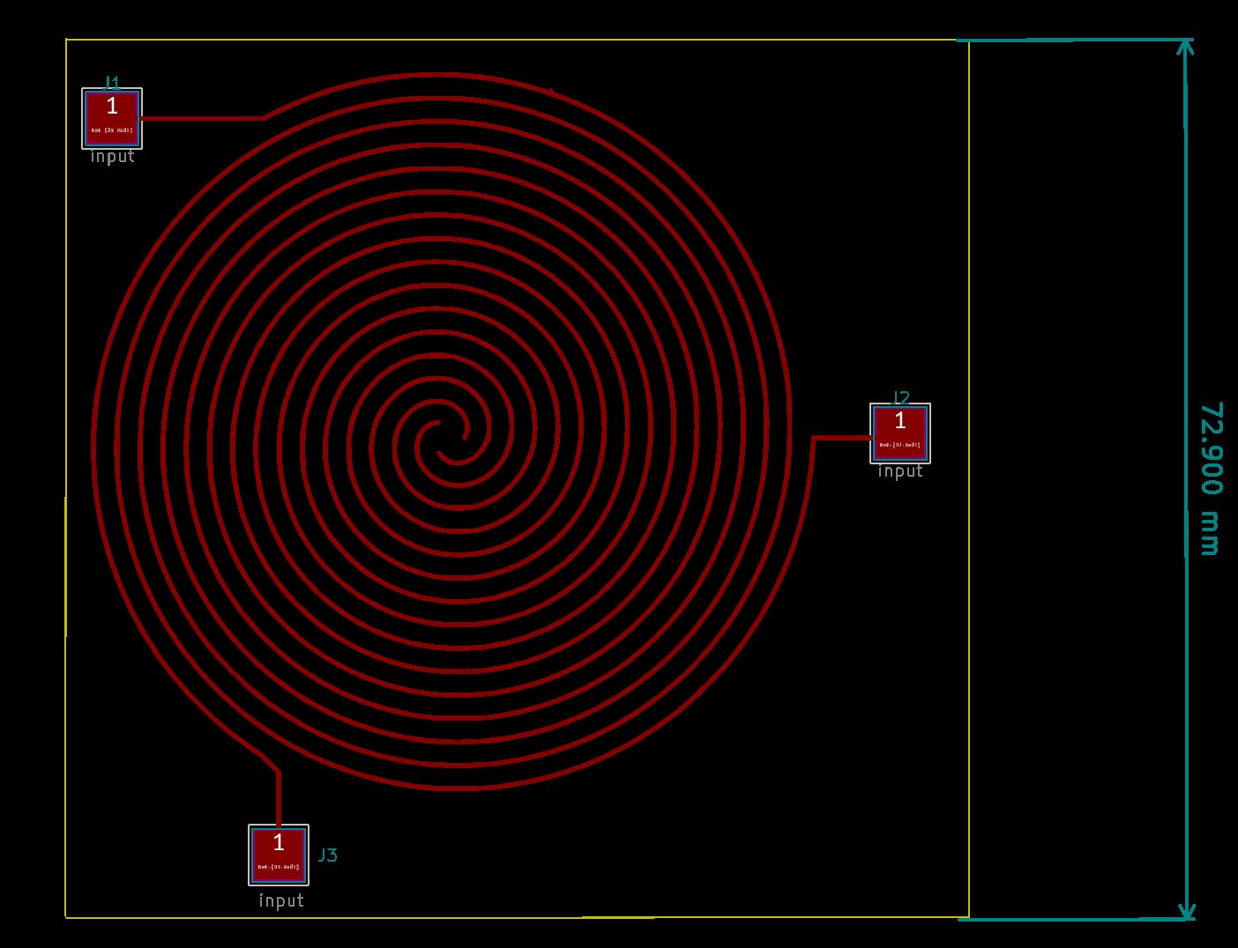
Electrical
EDS and Power Supply
04/09/21
Sorina Lupu
Figured out a way to develop fast and automatic EDS test PCBs using KiCAD and Python and advised the EDS team on future steps
Met the Power SubSystem team and discussed design considerations and safety
Developed a High Voltage PCB Best Practices & Safety Presentation (maybe present it next time?)
Next week: bootstrapping circuit (todo help design), discuss the arcing problem for the EDS board
KiCAD board EDS with 3 electrodes

Slide 10
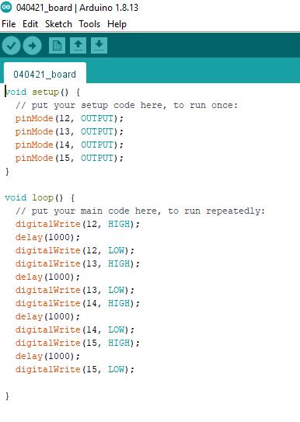
ELECTRICAL
ARDUINO WORK
04/09/21
Raha Riazati
Accomplished tasks
downloaded Arduino software
read through descriptions of basic Arduino functions (digitalWrite, pinMode) and overlap functions with C++ (if, do...while, etc.)
very basic outline of phase transition circuit
Arduino digital output only goes up to 5 V? analogWrite?
How much delay?

Slide 11
ELECTRICAL
Schedule, Next Steps, Budget
04/09/21
Raha Riazati
Budget
Little to no cost given many team members have an Arduino (need to figure out which one)
Schedule
Week 2 – Continue to program phase transitions
Week 3-5 – Operational mode programming involving the LED
Week 6-7 – Test design and optimize further
Week 8-10 - Implement more advanced designs/controls if desired
Next Steps
Learn more about phase transition mechanism (timing, voltage, etc.) to incorporate into design

Slide 12
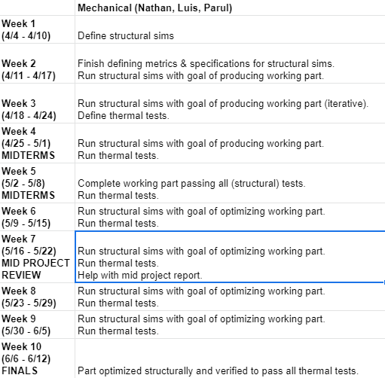
Validation
Schedule (Structural)
4/9/21
Nathan, Luis
Budget = $0
Need – confirmation of which materials (and thicknesses) will be possible to manufacture (Mechanical Team)
Need – maximum thicknesses for the top plate, possibility of adding metal plate under bottom panel (Electrical Team)

Slide 13
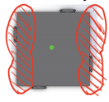
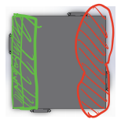


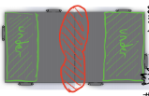
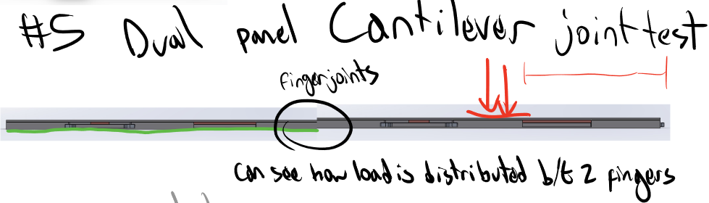
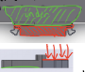
Validation
Structural Tests/Sims
4/9/21
Luis, Nathan
Planned structural tests
Whole Panel Tests
Three-point bend
Cantilever
Multiple Panel Tests
Dual Panel Three-point bend
Dual Panel Cantilever
Finger Joint Tests (sanity check)
Link
Loads (shown in red) are 486 N total
Fixed points shown in green

Slide 14
Validation
Simulations
04/08/21
Isabella Dula, Sarah Yun
Simulation Timeline and Objectives
O1: Create a robust and flexible model that can represent the dynamic electric fields in HOMES. The model should further validate results from other simulations and be open to changing various parameters to optimize in later steps.
Week: | Goal:
1 (Current status) | Researched methodology and identified key references; higher level code design; created documentation framework
2 | Define spatial-temporal domain, boundary conditions, initial conditions, physical parameters, and iteration structure; write out pseudocode and begin preliminary scripting; meet with an expert?
3 | Write out code; begin debugging and testing to meet O1
Next Steps: Talk to electronics team to determine which parameters are best to be considered for optimization. This could include modifying voltage, particle tracing, top plate thickness, electrode spacing, and electrode width

Slide 15
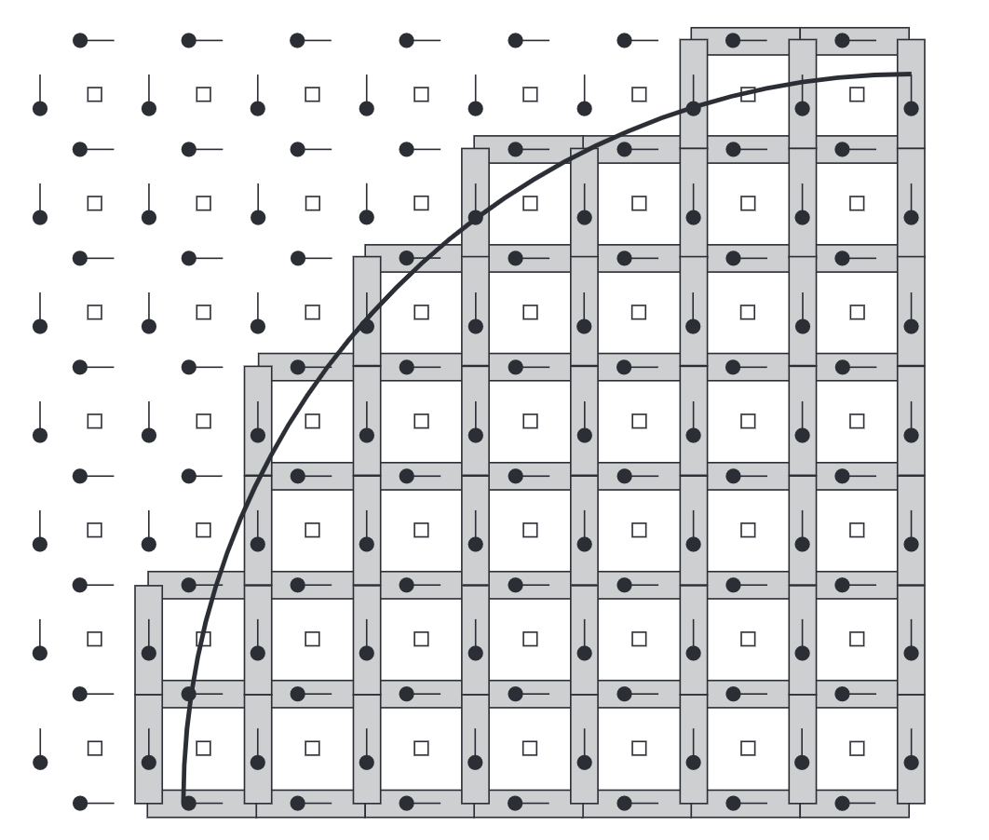
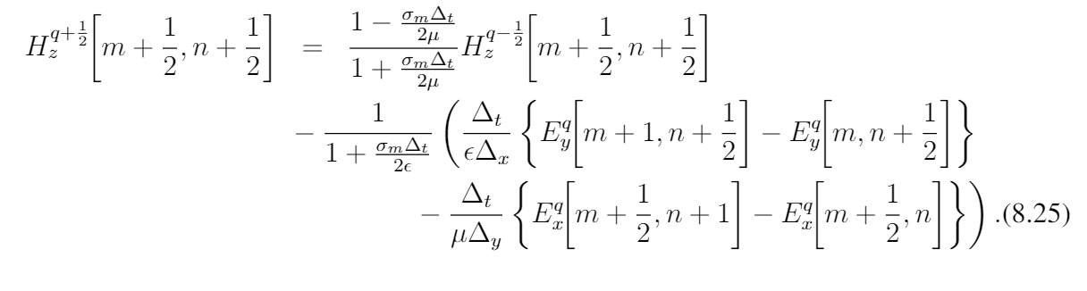
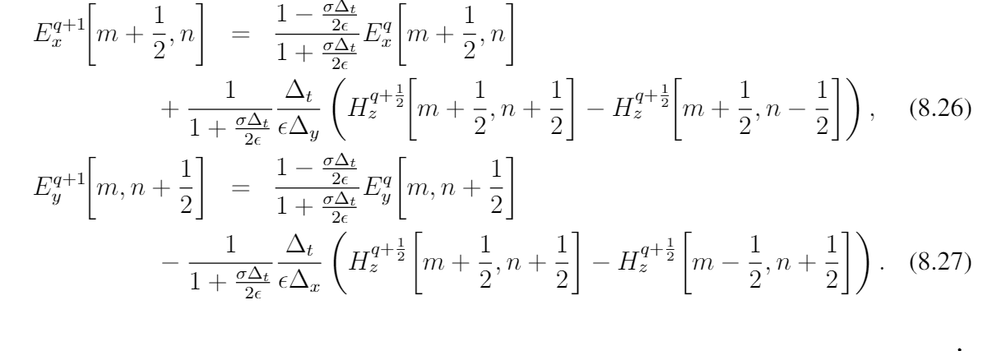

Validation
Simulations
04/08/21
Isabella Dula, Sarah Yun
Physics and the Finite Difference Time Domain Method
Physical domain
Boundary Conditions
Iteration Structure
-Define Parameters/structures: dx, dt, total dimensions, spatially-dependent properties
-Initialize electric field based on charge of electrodes
-for i in time domain
-Update time dependent state of electrodes
-Apply electrodynamic iteration equation:
-Reinforce boundary conditions
-end
-Data visualization
dt
dx
Electrodes modeled as perfect electrical conductors (E-field = 0)
Implement 2nd Order Absorbing Boundary Conditions at ‘edges’ of physical domain
$$c\frac{dt}{dx}=1$$
Many thanks to this resource: https://eecs.wsu.edu/~schneidj/ufdtd/

Slide 16
Validation
Simulations
04/08/21
Isabella Dula, Sarah Yun
Code
Considering either C or Python for the simulations
The book we referenced used C for FDTD simulations
Maybe C would have more flexibility since we can define our own data types with specific elements for each type?
However, Python may be easier to read, use, debug
Could represent physical aspects of HOMES in code as objects and give relevant attributes to the object
Ex) a node class with position, charge density, electric field, and etc as attributes
Represent the individual nodes on the grid
Already have some python code with various physical parts set up as classes
Create classes for various parts of HOMES
Represent grid as matrix
Array of arrays

Slide 17
Validation
Comsol
4/9/21
Malcolm
Comsol Objectives:
Validate results from Python simulations
Trace particles to optimize design
Introduce 3rd dimension to examine interactions between panels
Combine circuitry, magnetic, thermal, etc… into Multiphysics simulation for final validation
 | Sub-task
Week 1 (4/4 - 4/10) | Set up COMSOL
Week 2 (4/11 - 4/17) | Evaluate current 2D design for field strength and capacitance
Week 3 (4/18 - 4/24) | Implement particle tracing in 2D
Week 4 (4/25 - 5/1) MIDTERMS | Optimize partical locomotion on single panel in 2D
Week 5 (5/2 - 5/8) MIDTERMS | Evaluate current 3D design for field strength, capacitance, and inductance
Week 6 (5/9 - 5/15) | Implement particle tracing in 3D
Week 7 (5/16 - 5/22) MID PROJECT REVIEW | Examine particle tracing across multiple panels in 3D
Week 8 (5/23 - 5/29) | Optimize particle locomotion across panels in 3D
Week 9 (5/30 - 6/5) | Full multiphysics 3D simulation with circuit components
Week 10 (6/6 - 6/12) FINALS | BUFFER
Next Steps:
Debrief learning with Jules and Amrita.
Determine high priority simulations with electronics team.
Crack on

Slide 18
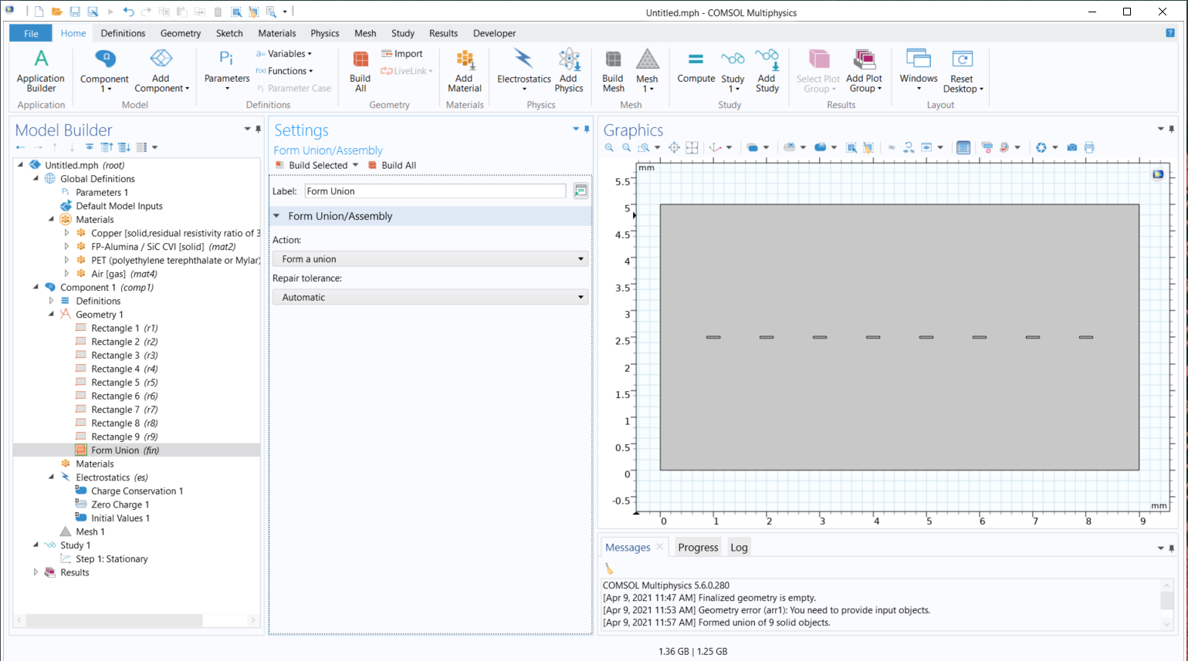
Validation
Comsol
4/9/21
Malcolm
Workflow
Select study type
Select domain type
Define parameters
Define geometry
Define regions
Define boundaries
Apply physics properties to corresponding domains and boundaries
Apply materials to domains
Generate mesh
Compute study
Evaluate results / post-process
Parameter sweep

Slide 19
MECHANICAL
Bottom Plate Manufacturing and Drawings
4/9/21
Leah Soldner
Technical Progress:
Reached out and got quotes for the bottom plate design
Scheduled meetings with several Macor manufacturers
Main issue with design is the 1mm thickness of the bottom lip on the plate
Have to increase the thickness to at least 3mm
The weight of the panel will increase by ~350 grams
Will not affect the price of manufacturing
Top sheet issue:
1mm too thin, will warp or crack during shipping
Tape casting as possible solution
Mateus makes 4.5x4.5 in plates of desired thickness
Action Items:
Set up meeting with Ceramic Products
Communicate with Mateus to see if we can increase the tape casting size
Update drawings with correct bottom plate thickness
Choose manufacturer and start ordering!!!

Slide 20
MECHANICAL
Bottom Plate Manufacturing and Drawings
4/9/21
Leah Soldner
Budget/Timeline:
Precision Ceramics: Mateus Truon, meeting Thursday (4/8)
1 plate: $1756.20
8 plates: $ 1080.50
Delivery time: 5-7 weeks
Morgan Advanced Materials: Nikhil Jani, meeting Wednesday (4/7)
1 plate: $2220.22
8 plates: $1843.03
Delivery time: 8 weeks
Ceramic Products: Mark Vidaic, meeting next week TBD
1 plate: $1450
8 plates: $1100
Delivery Time: 4-5 weeks
If we go with cheapest, estimated budget/timeline: $9,500/5 weeks
If we go with most expensive, estimated budget/timeline: $15,000/8 weeks

Slide 21
MECHANICAL
Panel Materials
04/09/21
Athena Kolli
Schedule
Week 2 – Reached out to Professor Faber about Macor and Potential Silicon use, awaiting response
Week 3 – Decide on manufacturers and place orders
Week 8 – Earliest Macor comes in, start panel assembly
Budget
~$2,000 per macor panel
$200 for adhesive
$?? Alumina (have to find the quote)
$?? Finger Joints
Next Steps:
Decide on use of Silicon
What will finger joints be made of? Get quote
Order materials

Slide 22
MECHANICAL
Testing Assembly
04/09/21
Athena Kolli
Schedule
Week 2 – Determine action items for testing assembly
Week 4 – Begin writing procedures for panel assembly
Week 5 – Design 3D print for initial panel testing with PCB
Week 7 - Begin testing PCB with 3D printed panel
Next Steps:
Write panel assembly procedure
Talk to Malcolm/verification team to clarify my role

Slide 23
MECHANICAL
ELECTRICAL ENCLOSURE DESIGN
04/09/21
Polina Verkhovodova, Tanmay Gupta,
Kristine Chelakkat
State of the art:
Electronics enclosures serve to shield sensitive components from the space environment
A common structural material for electronics enclosures is 6061-T651 aluminum
Fastened with screws and shear pins
Typical enclosure weighs about 4 kg
Potting of electronics to resist shock and vibration (need to research more about this)
Passive thermal management
Surface finishes: solar reflectors (quartz, aluminized Teflon), white paint (ex: Z98), black paint (3M Black Velvet), aluminized Kapton, metallic finishes
Aluminum has decent IR IR absorptivity and emissivity already
Consider black paint inside electronics box for temperature control inside
Inserts: MLI, Aerogel, Kapton, Beta cloth
CubeSats tend to use MLI
Active thermal management
Louvers (vents) (maybe??)
Pumps (this is too much for us)

Slide 24
MECHANICAL
ELECTRICAL BOX DESIGN
04/09/21
Polina Verkhovodova
Thermal Control System Design process:
STEP 1: Determine design requirements and constraints
STEP 2: Determine thermal environment
STEP 3: Identify challenges and problem areas
STEP 4: Identify applicable thermal control techniques
STEP 5: Determine radiator and heat requirements
STEP 6: Determine thermal control system mass and power

Slide 25
MECHANICAL
ELECTRICAL BOX DESIGN
04/09/21
Polina Verkhovodova
Electronics Enclosure design requirements (high level):
Shield to keep sufficient internal charging rate
Ground structural elements
Conductive path for circuitry
Thermal protection (consider extreme temperature range and thermal cycling)
Vibration tolerance
UV and ionizing radiation
Need to confirm components for lunar model (not earth-based prototype). Will use these to determine temperature ranges.
Usually, the component with the tightest temperature tolerance is the power supply. A power supply typically has an operational temperature range of 0 to 15 °C and a survival temperature range of -10 to 25 °C.

Slide 26
MECHANICAL
ELECTRICAL BOX DESIGN
04/09/21
Polina Verkhovodova
Lunar conditions summary (work in progress):
Temperature Range [°C] | -232 to 110
Geometric Albedo | 0.07
Orbit-Average IR [W/m^2] | 430
Values from Space Mission Analysis and Design textbook
Still looking for information regarding conditions at the south pole specifically

Slide 27
MECHANICAL
ELECTRICAL BOX DESIGN
04/09/21
Polina Verkhovodova
UV radiation
In general, aluminum is resistant to UV radiation
Not too big of a concern
Corrosion (WIP)
Corrosion is a concern! Some studies show that metals exposed to radiation are more susceptible to corrosion
Types of coatings to mitigate this:
Barrier coatings
Conversion coatings
Sacrificial coatings

Slide 28
MECHANICAL
CABLE DESIGN AND PROTECTION
04/09/21
Kristine Chelakkat
Specifications
Wire:
4 cables
High Voltage, 3000V
Shielded
Helps reduce electromagnetic and radio frequency interference from other devices
Important due to high voltage and proximity to other electrical components
Insulating outer coating
Connectors:
Able to keep dust out

Slide 29
MECHANICAL
CABLE DESIGN AND PROTECTION
04/09/21
Kristine Chelakkat
Cicoil
Approved by NASA for space flight; Used in Apollo
Up to 12-20kV DC (depending on gauge size)
Shielding: 90% nominal coverage
Temperature Rating: -104C to +165C
Outer Jacker Dielectric Strength: 450 volts/mil
Comes with connectors attached

Slide 30
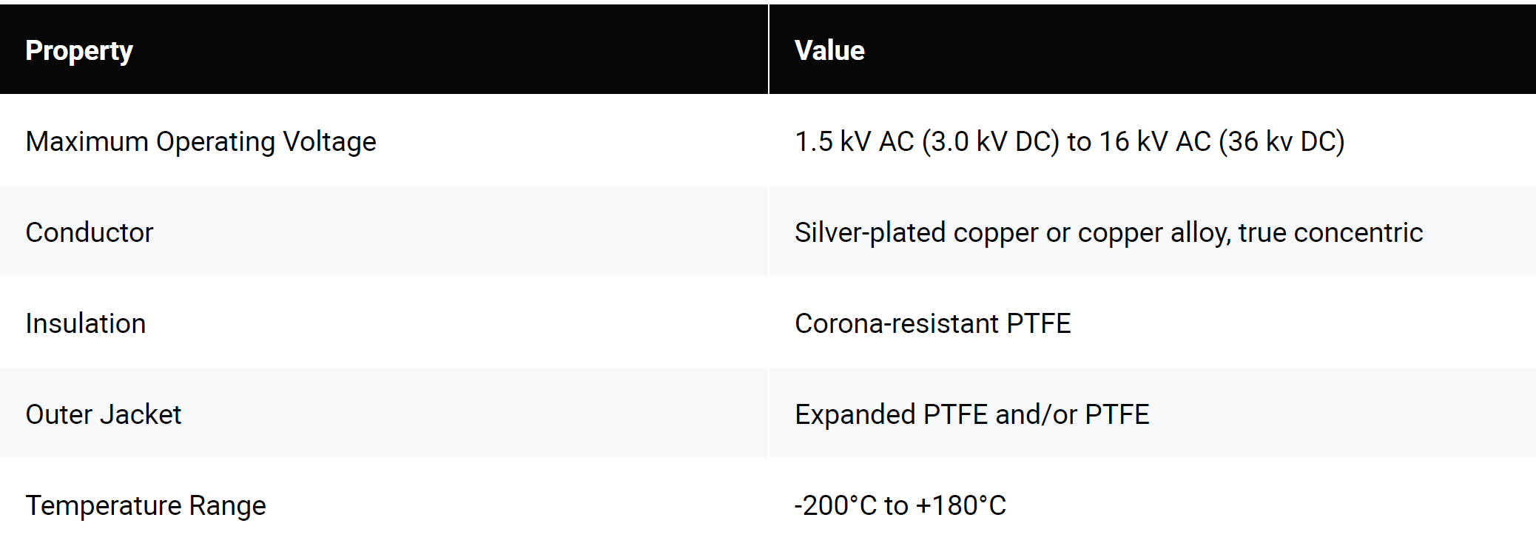
MECHANICAL
CABLE DESIGN AND PROTECTION
04/09/21
Kristine Chelakkat
Gore
Previously used in space missions like Apollo and Mars Rover, and many other satellite missions
No information about connectors – may have to manually add

Slide 31
MECHANICAL
CABLE DESIGN AND PROTECTION
04/09/21
Kristine Chelakkat
Next Steps
Contacting engineers with HV experience in the space industry
Contacting suppliers for samples
<$20/foot from Cicoil
May be able to request Gore for a free sample
Testing Cable

Slide 32
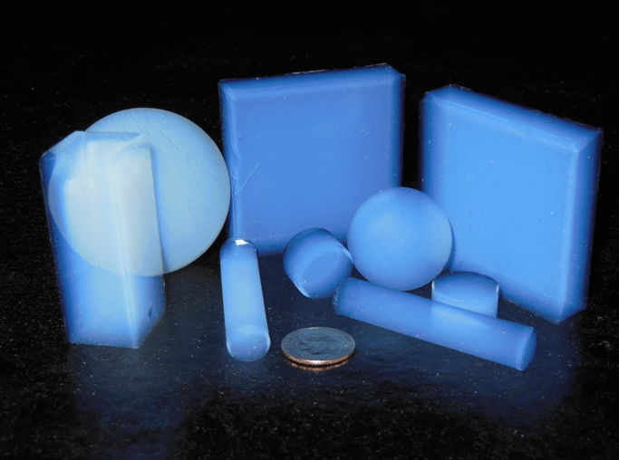
Mechanical
Electronics Box Insulation
04/09/21
Tanmay & Polina
Aerogel
Most likely in conjunction with MLI (see Polina’s slides)
Lightweight, great insulator
Need something beyond just reflecting heat
Enhances heat retention inside box
Procurement: Caltech MS labs, JPL extras, NASA license
Already used in spaceflight
carbon-based or silica or metal oxides (outgassing?)
Thin film aerogel by NASA is promising
NASA Link

Slide 33
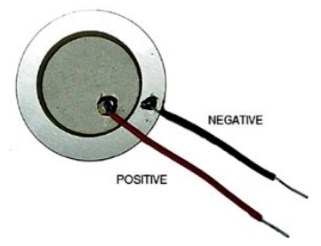
Mechanical
Electronics Box Touch Sensor
04/09/21
Tanmay Gupta
Astronaut Touch Controls
Button could get “clogged” by dust
adds a point of dust ingress and point of failure
Use a touch based alternative
3 alternatives: Capacitive sensor, Piezoelectric Transducer, Strain Gauge
Piezoelectric Transducer
Best option given enclosure
generate signal/voltage change based on pressure
Adjust sensitivity to require reasonable astronaut tap pressure
Coupled with LED for status information
Already used in rockets
Cost-effective

Slide 34
VERIFICATION
Schedule & Progress
04/09/21
Calle Junker, Kaila Coimbra, Sydney Richardson, Parul Singh
Summarized Schedule
Week 2 and 3
Determine parts for all tests
Receive quotes for outsourcing tests (see link)
Finalize all rig designs
Week 4
Begin construction of all rigs (LTE, abrasion, glove box)
By Week 7, all rigs should be constructed and ready
We will be conducting benchtop testing when prototypes are complete
Additional Links
Quotes: https://docs.google.com/document/d/1JMS6xeg2GfDGNQWzqpF8xgkdXztxX7Pl_0HX3a9pVhU/edit?usp=sharing
Detailed 10 Week Schedule: https://docs.google.com/document/d/1fI2mnGXqogZx00UyyNW2b-N-qA4sxLObzkvph_nNB3M/edit?usp=sharing

Slide 35
VERIFICATION
Benchtop Testing
04/09/21
Calle Junker
Schedule
Week 2 – Determine necessary parts and budget
Week 3 – Place order for all needed parts
Week 5 – Begin electronic benchtop testing
Week 10 - Begin mechanical benchtop testing
Budget
$200 for oscilloscope, EMF detector, etc.
$800 for mechanical benchtop testing
$600 for LN2, dewar, and safety equipment
$200 for impact testing, loading
Estimated $1000 total

Slide 36
VERIFICATION
Glovebox
04/09/21
Calle Junker
Schedule
Week 2 – Determine necessary parts and budget
Week 3 – Place order for all needed parts
Week 4 – Begin assembly
Week 5 – Glove box complete and ready for use
Budget
Estimated budget approximately $2000
See spreadsheet in additional info for detailed breakdown of part costs (does not include nitrogen tank)
Additional Info:
https://docs.google.com/spreadsheets/d/1eCWXm6SFHYvjiBSH6nSlmXVNTzdUf-_WXcTQ4h48kic/edit?usp=sharing
https://docs.google.com/document/d/1U8Kxp_ktJtrzEqrkx59jmgzuCbHyqj02b4jm5AmzpwA/edit?usp=sharing
Next Steps:
Finalize attachment method with frame
Complete CAD of glove box assembly
Place order of all parts

Slide 37
VERIFICATION
EFFECTIVENESS TESTING
04/09/21
Rithvik
Schedule
Budget
Week Start Date | Tasks
2021-04-12 | Purchase Equipment
2021-04-19 | Start Building Frame
2021-04-26 | Continue Building Frame Start Writing Code to Analyze Results
2021-05-03 and Subsequent Weeks | Finish Building Frame Finish Writing Code Start Running Effectiveness Tests
Item | Cost
Camera | $3000
Lights | $150
Aluminum Rails | $500
Connectors and Feet | $400
Grounding Hardware and Power Cords | $150
Total | $4600

Slide 38
Verification
Thermal Fluctuation Testing
04/09/21
Sydney
Test Outline
Testing one panel, -170℃ to +130℃, air-to-air or liquid-to-liquid, 30 exposures then start-up and shut-down electronics 15 times, 5-10 minute dwell time, 189 cycles total
Testing Quotes
NTS
$40,500
Grays Engineering
TBD
Oneida
TBD

Slide 39
VERIFICATION+VALIDATION
Abrasion Rig Plans and Simulation Plans
4/9/21
Parul Singh
Budget/Timeline for Abrasion Rig (assuming we have to build our own):
Abrasion Rig Parts Needed and approximate cost:
Motor, large wheel with rubber rim, metal frame, loading weight, abrasive dust simulant, tarp
Main cost is the motor, all parts together should be $1500 max (prob closer to $1000)
However this is a rough first-look estimate, will hash out details this weekend
Timeline
Week 2 - Finalize parts list and design for abrasion rig
Week 3 - Get quotes/ Order parts
Week 4 to Week 7 - Building the rig (somebody in Pasadena will have to do this as I am remote))
This depends on when all parts come in
Note about Validation:
Next week: Collect parameters needed for thermal sims like strength constants for varying temperatures, read about thermal cycling sims to figure out best plan

Slide 40
VERIFICATION
Long Term Effectiveness (LTE) Test
04/09/21
Kaila Coimbra
Schedule
Week 2 – Determine necessary parts
Week 3 – Place order for all needed parts and finish LTE rig design
Week 4 – Begin assembly
Week 5/6 - Finish assembly and test if operational
Week 7 – LTE rig is fully constructed and ready for use
Budget
Estimated budget of approximately $800 (rough upper estimate based on materials found)
Additional Info:
https://docs.google.com/document/d/1si6GRTnZiIqzqADaSfvcGlQJqSmV7rVR-7y3NoNxfhg/edit?usp=sharing
Next Steps:
Finalize budget
Complete CAD of LTE rig
Place order of all parts

Slide 41
Admin / Documentation
Mid-Project Report
04/09/21
Helen Wexler
Proposed Timeline for Report
April 22nd - outline report sections and sync up with main content creators
May 6th - internal deadline: first draft of report (feedback from team members)
May 10th - internal deadline: second draft of final report (feedback from external advisors)
May 17th - internal deadline: post feedback revisions
May 17th-May 20th: editing, formatting and visual design of the report
May 20th – External deadline (NASA): mid-project report due

Slide 42
Summary
Action Items
04/09/21
Helen Wexler
To Do
Complete Survey
Fill in Gantt Chart for your Task
ORDERS ORDERS ORDERS
Sub-team Meetings and Technical Work
Upload Week 3 Slides

